Slide 1

Smart Classroom Management System
RoopaShree O
and
Hamsa V
Notes:
NOTE:
To change the image on this slide, select the picture and delete it. Then click the Pictures icon in the placeholder to insert your own image.

Slide 2
Content
Introduction
Objective/Purpose
Deployment Design
Schematic diagram
Working Principle Explanation
Conclusion and References

Slide 3
Introduction
The internet of things (IoT) is a recent communication paradigm that shows near future devices or objects equipped by microcontroller , sensors , transceiver and appropriate protocols which makes these devices interactive using internet.
Such a technology can be implemented to make management of class rooms availability , checking for power wastage ,sensing danger like fire and gas explotion etc.
This real time management of resources helps better management of classrooms like calculating the amount of electricity used by the electronic devices such as fan , lights etc

Slide 4
Objective/Purpose
Automatically Sense the objects
As soon as the objects are sensed lights and fans are switched on
The amount of electricity used by each classrooms by electronic devices are calculated
Easy maintenance of resources
In case of emergency such a fire and smoke the fans are automatically switched on and message is sent to the mobile applica

Slide 5
Deployment Design
Local
Cloud
App
REST/WebSocket communication
REST/Web Socket services
Database
Controller Service
Resource
Device
Monitering node performs analysis ,stores data

Slide 6
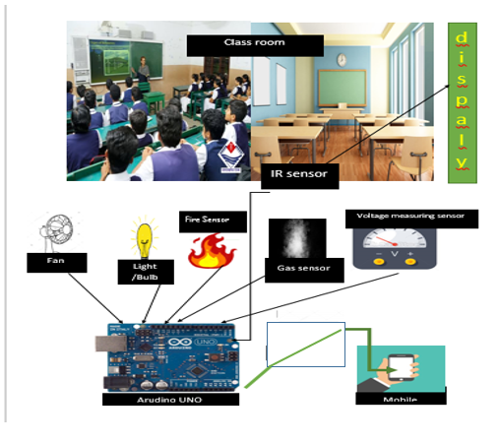
Schematic diagram

Slide 7
Working Principle Explanation
The Smart Classroom Management System administers the assets present in the classroom such as fan , lights , projector etc
The proposed system uses various sensors to perceive data .The sensors used are PIR sensor , IR sensor ,Smoke sensor and Fire sensor, working of these sensors is as follows:
PIR sensor also known Passive Infrared sensors ,it detects emitted infrared energy from objects (humans and animals, but also cars) in the form of heat.
IR sensor (Infrared sensor) it scans IR signals in specific frequency ranges defined by standards and converts them to electric signals on its output pin (typically called signal pin).

Slide 8
Working Principle Explanation
Continued……
Smoke sensor detects smoke as a primary indication of fire. It provides a signal to the mobile application stating ”Smoke is detected”
Fire sensor to detect and respond to the presence of a flame or fire, allowing flame detection and sends message to the mobile application.
When an object is detected by IR or PIR sensor automatically lights get switched on and message is sent to the mobile app
The amount of current used by the electronic appliances is calculated and displayed on the mobile app
The wifi module establishes the connection using a wireless adapter to create hotspots
LDR (Light Dependent Resistor) Photo conductivity is an optical phenomenon in which the materials conductivity is increased when light is absorbed by the material.

Slide 9
Conclusion
The Smart Classroom Management allows to Make classroom interactive and automatically checks availability of classrooms
This system reduces the time consumption
Minimizes the human resources
Keeps the track of Resources and its usage
References
https://www.globalgiving.org/projects/smart-classroom-for-poor-children-education/reports/
http://www.vkmaheshwari.com/WP/?p=2352
https://slejournal.springeropen.com/articles/10.1186/s40561-018-0070-1

Slide 10

THANK YOU

